Slide 1

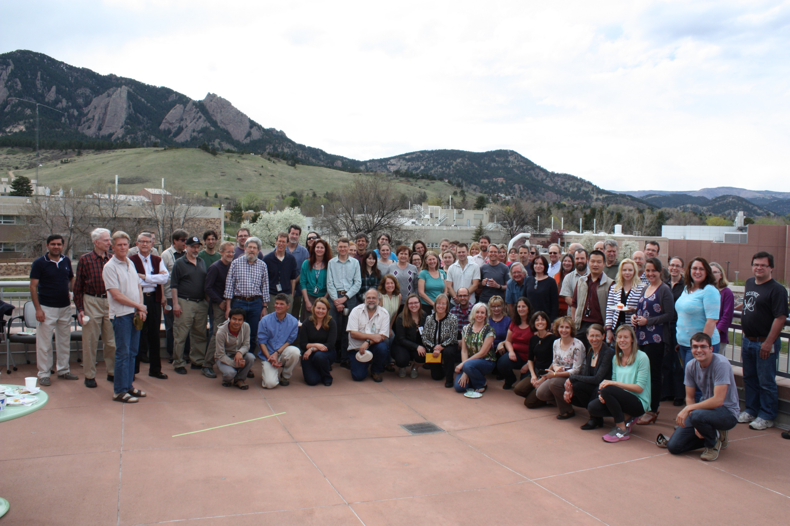
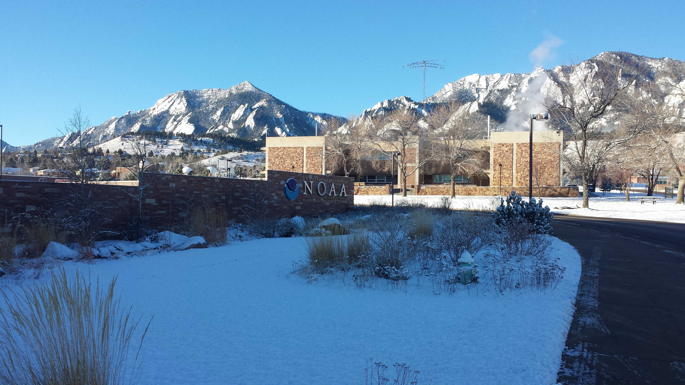
Recent work: National Oceanic and Atmospheric Administration (NOAA)
Bernard Mason: 02/12/2016
Two year position in Boulder, Colorado: 08/2014 - 07/2016
Research Scientist under Dr Daniel Murphy in the Clouds and Aerosol Processes group of the Chemical Sciences Division (16 people).
Focus on measuring and analysing data of aerosol absorption.
Aims of the project:
To fix, improve and get field-ready, the Aerosol Optical Properties (AOP) instrument.
To analyse data taken using the aerosol optical instrument during previous campaigns.
Attended AGU in 2015 and wrote a paper (almost done!).

Slide 2
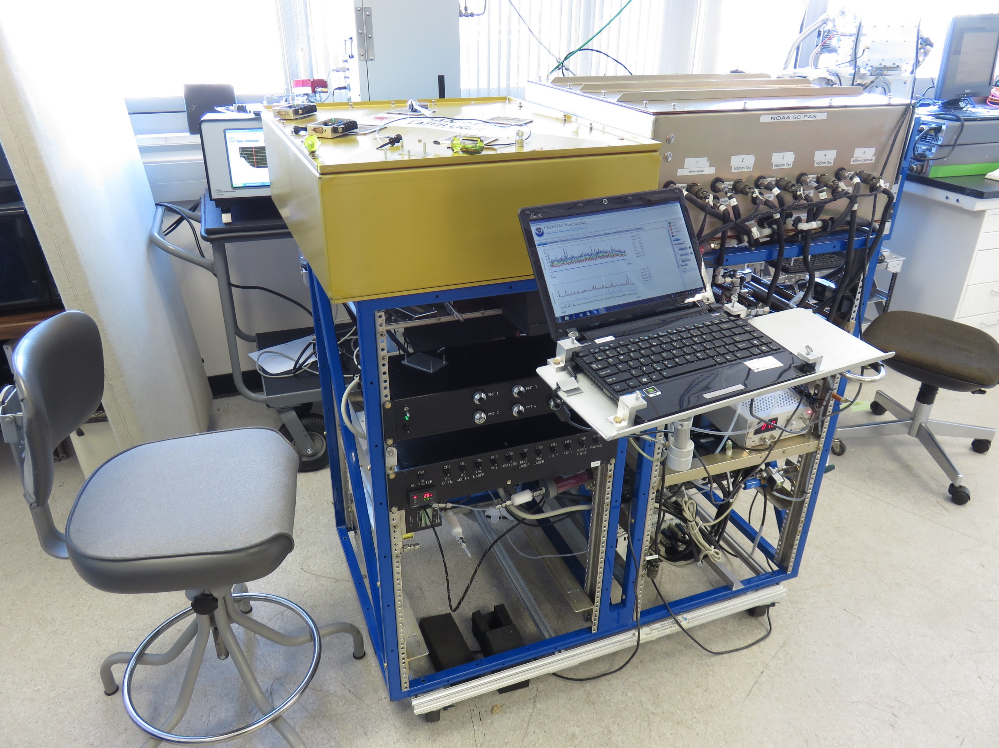
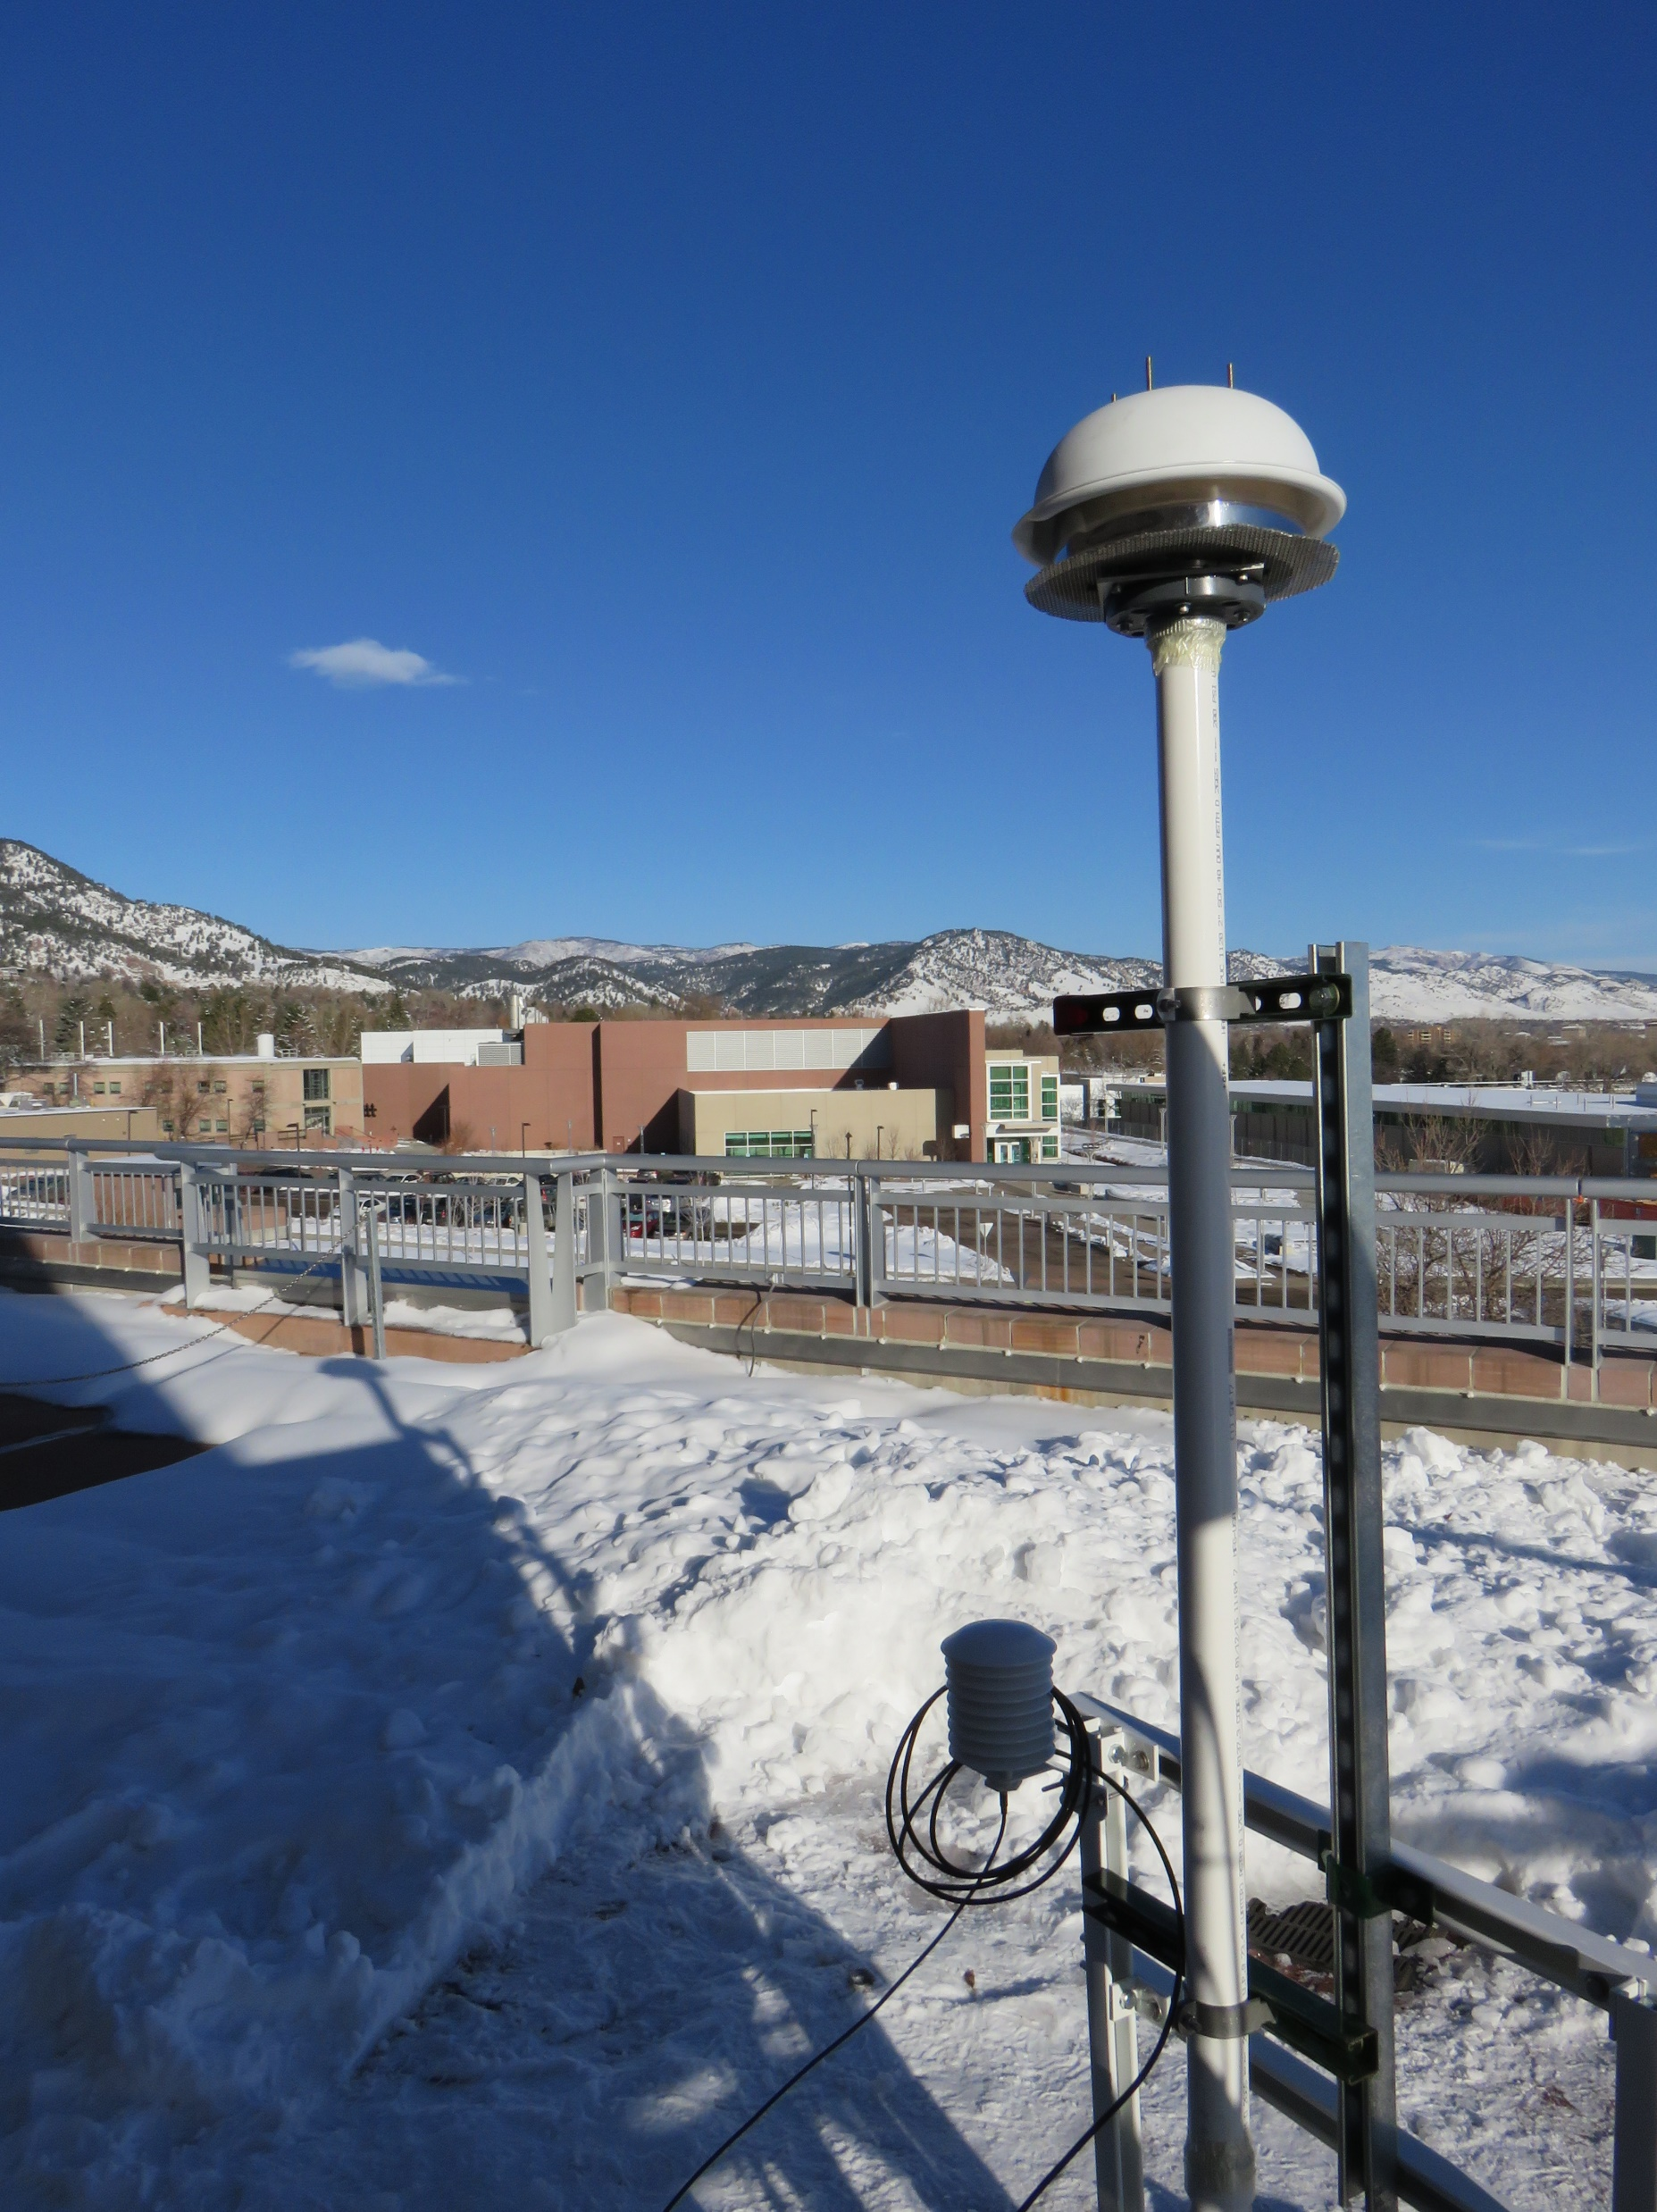
Aerosol Optical Properties (AOP) instrument development
Cavity ring down spectrometers (CRDS, 8) – measuring light extinction at 3 wavelengths with humidity control
Photoacoustic spectrometers (PAS, 5) – measuring light absorption at 3 wavelengths
Focus on development of the photoacoustic instrument:
Get the instrument operational: Update hardware and software.
Develop a new calibration method.
The method being used at the time was giving erroneous calibrations. Have since warned other PAS users of this.
Test the instrument in the field.
March 2015: HaGIS study: deployment on the NOAA roof.
Intercompare the instrument to other absorption measurements:
Compare against the Global Monitoring Division PSAP (also at NOAA).
Check agreement at a variety of particle single scattering albedos.
Ongoing.

Slide 3
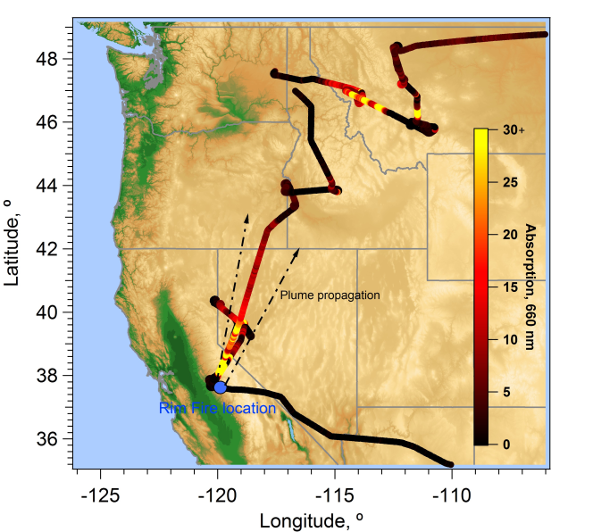
Analysis of SEAC⁴RS data
2013: Studies of Emissions and Atmospheric Composition Clouds and Climate Coupling by Regional Surveys – 19 flights
Focus on the absorption data: What is the absolute absorption in the plumes? What is the single scattering albedo
Process the PAS data: new routines plus a correction for calibration issues.
To intercompare the PAS with other absorption measurements (CLAP and PSAP) on board the DC8 aircraft.
To determine any differences between single scattering albedo (SSA) in different plume types: biomass burning and agricultural.
Instruments were well correlated and agreement was between 5 and 30 % (λ)
SSA (blue, 405 nm) | SSA (green, 532 nm) | SSA (red, 660 nm)
0.931 – 0.942 | 0.942 – 0.954 | 0.915-0.946
No significant difference between ag. fires and biomass burning. SSA of backgrounds slightly higher in red and green. Net cooling over these surfaces.

Slide 4
Extra slides:

Slide 5
Aircraft Cavity Ring-down Spectrometer – Photoacoustic Spectrometer
τ₀ τ
ext, b_{ext}
PMTs
v
PDs
v
v
Optical
cavities
v
v
v
v
v
v
PAS
cells
Multi-pass
mirrors
V_{mic}
v
v
v
v
Microphone
Notes:
CRD- Aerosol ext at multiple wavelengths and humidities. PAS – measure absorption at multiple wavelengths and dry conditions. Extinction measurement is fundamental whereas PAS measurement it’s not feasible to relate the response to absorption. Needs to be calibrated.
New slide (objectives).
Characterisation of the instrument: Understanding calibration (accuracy) of the PAS. Determination of sensitivity, detection limits.
Measurements:
New slide:
Calibration methods for photoacoustic measurements. O2 lines. Cell constant (NIST). Our options are absorbing gases/aerosols. Currently active research programs (NIST) at developing absorbing aerosol standards but there are aren’t any yet. These would be useful for calibrating a number of instruments. Absorbing gases are useful as no aerosol generation needs to be perform. Options are O3 and NO2. Calibration ideally needs to run in-flight. NO2 is photolysed more easily and O3 easier to generate. Absorption cross-section for O3 is much lower for the blue wavelengths used here so much higher concs are required (100s ppm).
Explain what PAS is – cartoon.

Slide 6
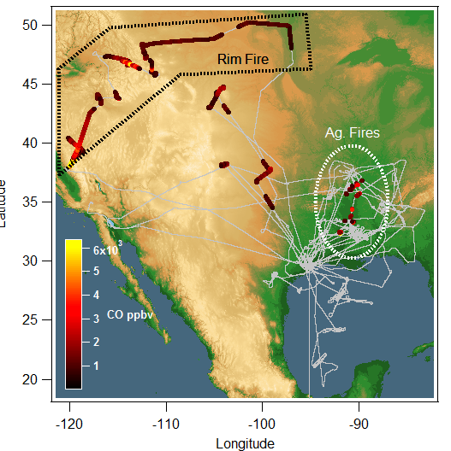
Plume Absorption
Measurement | λ = 405 nm | λ = 532 nm | λ = 660 nm
PAS SSA | 0.915 ± 0.016 | 0.942 ± 0.014 | 0.931 ± 0.019
PSAP SSA | 0.946 ± 0.014 | 0.954 ± 0.007 | 0.942 ± 0.010
CLAP SSA | 0.929 ± 0.018 | 0.943 ± 0.012 | 0.933 ± 0.016
Neph/CRDS SSA | 0.991 ± 0.038 | 0.988 ± 0.034 | 1.031 ± 0.048
PAS MAC_{SP2} | 61.2 ± 20.7 | 26.8 ± 10.5 | 19.2 ± 7.7
PAS MAC_{TD_ SP2} | 29.1 ± 12.2 |  | 12.3 ± 5.7
PSAP MAC _{SP2} | 38.3 ± 8.8 | 21.0 ± 5.3 | 15.2 ±. 3.8
CLAP MAC _{SP2} | 52.2 ± 18.7 | 26.5 ± 9.3 | 18.2 ± 6.1
Bond MAC(Bond and Bergstrom 2006) | 10.2 ± 1.6 | 7.8 ± 1.2 | 6.25 ± 1.0

Slide 7
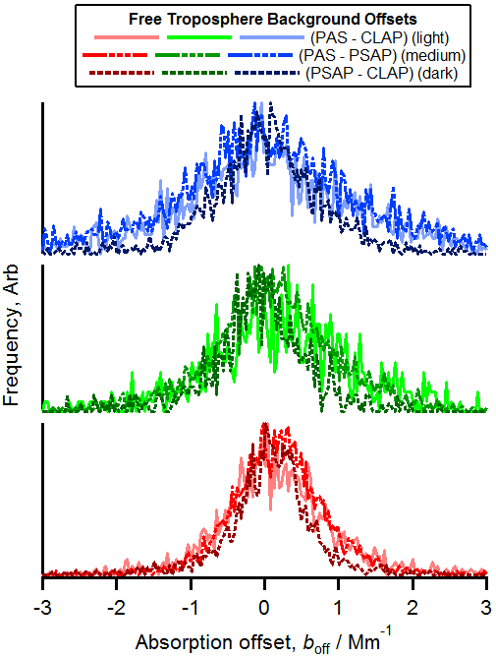
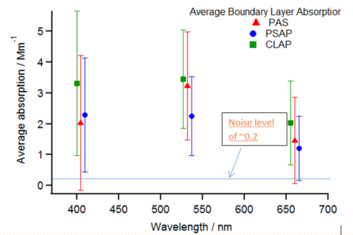
Background Absorption
Instrument pair (Mm⁻¹) | λ = 405 nm | λ = 532 nm | λ = 660 nm
PAS CRDS SSA | 0.97 ± 0.04 | 0.96 ± 0.03 | 0.94 ± 0.04
PSAP CRDS SSA | 0.96 ± 0.03 | 0.97 ± 0.03 | 0.93 ± 0.04
CLAP CRDS SSA | 0.94 ± 0.05 | 0.95 ± 0.02 | 0.91 ± 0.06
Table 5: Single scattering albedos using the BL absorption for each instrument with fit uncertainty. Each cell shows the Gaussian peak ± two standard deviations.

Slide 8
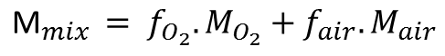
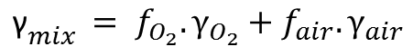
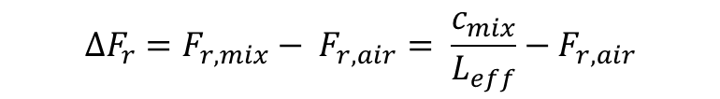

Correcting for O₂
O₂ flow out of the generator at each step determined.
Fraction of O2 flow (f_{O2}) and filtered air (f_{air} = 1- f_{O2}) calculated from the added and total flows.
The mixed gamma (γ_{mix}) and molar mass(M_{mix}) are obtained linearly and the speed of sound obtained:
$${\text{γ}}_{mix }= f_{O_{2}}.γ_{O_{2}}+f_{air}.γ_{air}$$
$$c_{mix}=\sqrt{\frac{γ_{mix}RT}{M_{mix}}}$$
$${\text{M}}_{mix }= f_{O_{2}}.M_{O_{2}}+f_{air}.M_{air}$$
F_{r,air} = 1353
The frequency shift of the cavity due the presence of oxygen can then be calculated from the speed of sound the effective cavity length:
$${ΔF}_{r}=F_{r,mix}− F_{r,air}= \frac{c_{mix}}{L_{eff}}−F_{r,air}$$

Slide 9
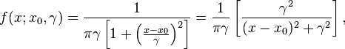
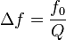
Correcting for O₂
Show that resonant frequency spectrum of a PAS cell is well approximated by a Lorenztian (top right):
Where Δf is the FWHM of the function and γ here is the HWHW.
The Q correction factor can thus be determined from the ratio of two Lorenztian functions.
For each O₂ concentration a correction factor is applied to the data used for determining the calibration slope.
Overall effect on the calibration slope and thus the measured absorption coefficients for a sample data set:
Red Den | Green dry | Red Dry | Blue Dry | Blue Den
1.07 | 1.03 | 1.07 | 1.24 | 1.19

Slide 10
Carrier gas influence on calibration
O₃ generator turned on and O₃/O₂ mixture allowed in the system. Mixture flow is 0.028 of total flow and expected ΔF_{r} is -2.1 Hz.
At each step change in O₂ concentration the F_{r} and Q of the cell is re-measured. Shown is for PAS cell 1 (red).
The step changes in F_{r} unsurprisingly follow the changes in O₂ concentration.
Finally, a ‘traditional’ auto-calibration is performed.

